Slide 1
CAT
Computer Aided Teaching
Notes:
Notizen durch Klicken hinzufügen

Slide 2
“I hear and I forget.
I see and I remember.
I do and I understand.”
(Lao Tse, -500)
Notes:
Notizen durch Klicken hinzufügen

Slide 3
Concept
No “Talk and chalk” lecture
No written or oral exam
Students have to read textbook for preparation
Contact hours = practice hours
Double teams in computer lab
“Hands-on”, “Learning-by-doing”
Individual state of knowledge examination by the lecturer every week
Notes:
Notizen durch Klicken hinzufügen

Slide 4
Communication
Lecturer
Matlab
Browser, ASP.NET, MathML
.mlx
Database, XML
mlx1.mlx
Task
Template
Answer
Comment
Grades
.slx
Student
Notes:
Notizen durch Klicken hinzufügen

Slide 5
Links
Learning environment:
https://m-server.fk5.hs-bremen.de/cat/login.aspx
Lessons learned:
https://m-server.fk5.hs-bremen.de/maus/Maus.pdf
https://m-server.fk5.hs-bremen.de/maus/duz_2007.png
https://m-server.fk5.hs-bremen.de/maus/duz_2008.png
Notes:
Notizen durch Klicken hinzufügen

Slide 6
“Disadvantages”
“I know how to solve that integral; why do I have to teach that stupid machine how to do it?”
“At the beginning (about the first 6 weeks), Matlab really got on my nerves, but after you understand how Matlab thinks, it’s ok.”
“Helpless without a computer. What if there is a power outage?”
Notes:
Notizen durch Klicken hinzufügen

Slide 7
Advantages
Use of modern tools (industry standard)
Understanding more important than cooking recipes
Immediate success control
Big self-learning ratio (Distance learning)
Utilization in other subject areas
Soft skills, teamwork, writing skills
Fun factor
Notes:
Notizen durch Klicken hinzufügen

Slide 8
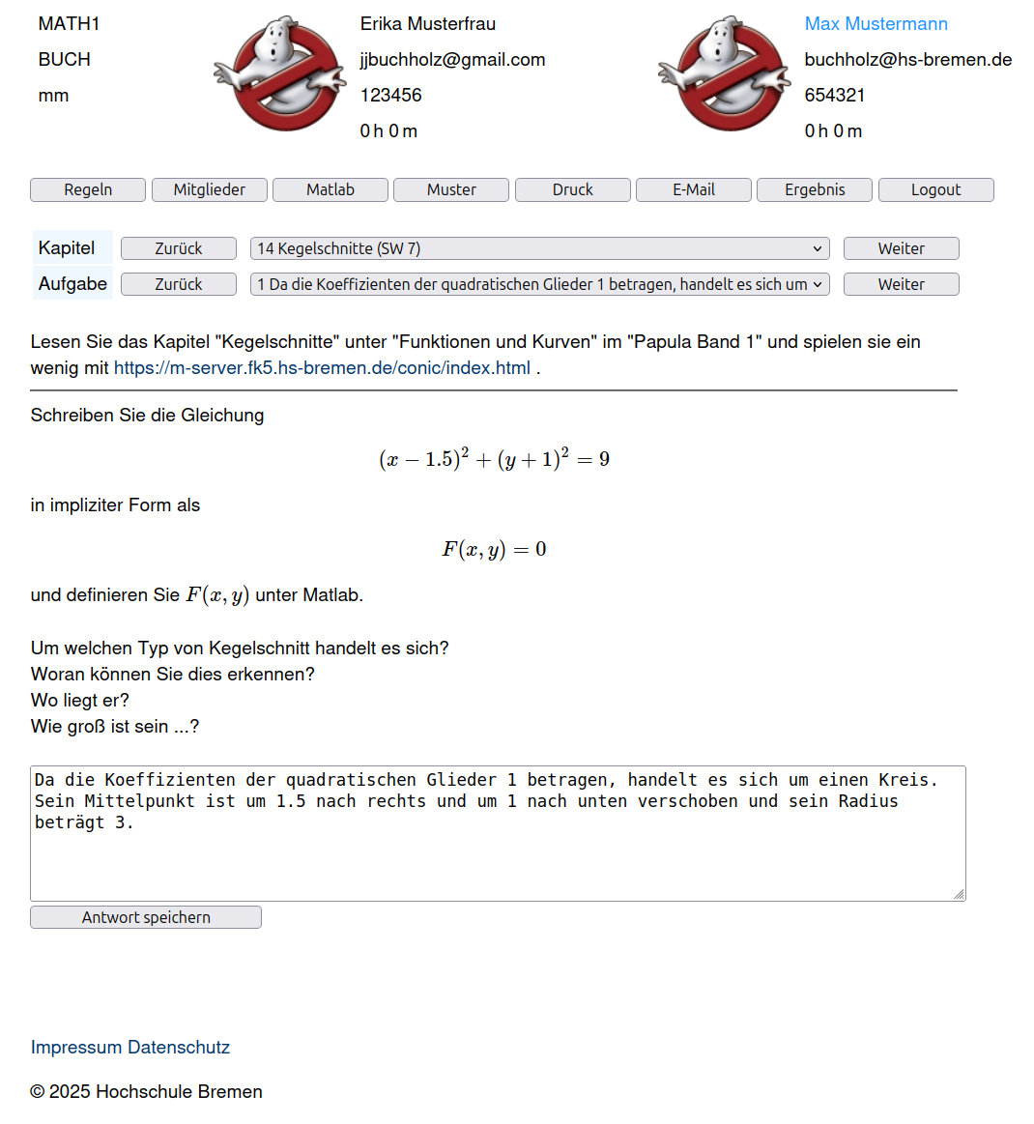
Student’s view

Slide 9
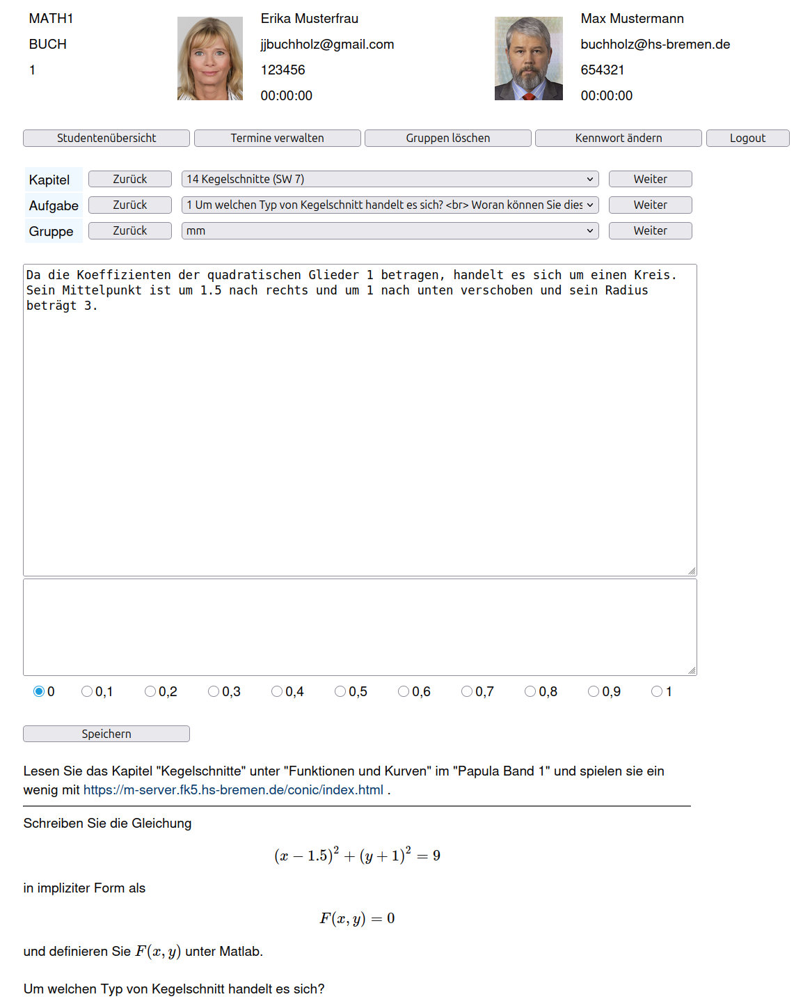
Lecturer’s view

